Slide 1
Foundation
Deposit Transmittal Training
FY 2021-22
Notes:
Introduction-Yelena, do you want me to do this?

Slide 2
Presentation Highlights
Gift Acceptance
Supporting Documentation
Completing the Deposit Transmittal Form (Foundation)
Key Performance Indicators (KPI)
Completing the Pledge/Gift Agreement Transmittal (Advancement)
Foundation Advancement Initiative
Expense Reimbursement Deposit Transmittal Form
Foundation
Notes:
I can also read this slide

Slide 3
Life Cycle of a Deposit
Donor gives Cash / Check / Credit Card is charged
Dept creates Deposit Transmittal and submits to Foundation along with supporting documentation
Foundation deposits to bank and records to PeopleSoft AND sends to Advancement
Advancement enters gift in RE, updates donor info, receipts/acknowledges donors
Dept uses funds to fulfill the donor’s intent
Foundation
Notes:
Maybe Yelena

Slide 4
Gift Acceptance
FIU Foundation, Inc. is a 501(c)(3) tax exempt organization
Exists to encourage, solicit, receive and administer gifts for scientific, educational and charitable purposes for the advancement of FIU and its mission
What is a charitable contribution?
A donation or gift to, or for the use of, a qualified organization
Voluntary and is made without getting, or expecting to get, anything of equal value
A donor may NOT retain any explicit or implicit control over the use of a gift after acceptance by the organization
Foundation

Slide 5
Is this a gift?
Sponsorships where donor only receives name/logo recognition are considered a gift
Donation where the donor only receives token items valued at $10.70 or less are considered a gift
Donation where the donor only receives “insubstantial benefits” are considered a gift
Insubstantial is defined as a benefit of 2% or less of the gift amount and is capped at $107 (for 2017)
Philanthropic grants requiring acceptance by a 501 (c)(3)
Foundation
Notes:
Olema

Slide 6
Supporting Documentation
Documentation of the donor’s intent for the use of the funds
Gift Agreement
Any written communication from the donor (letter, email, memo line on check, etc.)
Pledge Card/Agreement
Ignite Campaign documentation
Action item (entered interaction with donor in Raiser’s Edge NXT)
Grant application including detailed budget if required by the grantor
Foundation

Slide 7
Deposit Transmittal Form
Must accompany any donation to be deposited in the Foundation (use a separate form for expense reimbursements)
Ensures proper recording of your department’s funds
Ensures accountability to our donors
Supports the proper flow of information to management on fundraising goals
For the latest form please visit: https://give.fiu.edu/about/fiu-foundation/online-forms/index.html
Foundation
Notes:
Maybe Yelena-access to the site and from there we can do the training

Slide 8
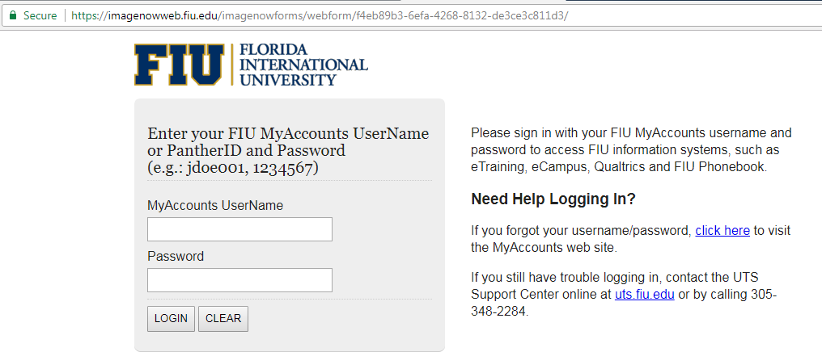
Completing the Deposit Transmittal Form
Click on the link to prepare the deposit transmittal form
Log in by entering your FIU MyAccounts Username/Panther ID and Password
Foundation

Slide 9
Completing the Deposit Transmittal Form
Contact PID, Date and Department: automatically entered when you log in
Requested by PID: Panther ID # of individual for whom you are the completing the form (not a required field, will default to Contact PID)
Solicitor ID: Panther ID # for the corresponding solicitor (Major Gift Officer) for this gift. Please contact the Advancement Office #7-3623 or #7-2472 if not known. The form allows for multiple solicitors to be selected.
Was a board member involved with soliciting this gift?: Select from the dropdown box “yes” or “no”. If yes, select the board member who was involved with soliciting this gift.
Foundation
Notes:
Olema-talk about solicitor and BOD member

Slide 10
Completing the Deposit Transmittal Form
What key performance indicator (KPI) does this gift advance? Select one of the following or indicate that none apply:
Student Support – this includes support for scholarships, internships, conferences, mentoring programs, extracurricular training or professional opportunities. Also, initiatives that impact STEM (science, technology, engineering, and math) education, improving first to second year retention rate of our first time in college students, boosting our six year graduation rate, improving our four year graduation rate of state college transfer students, increasing enrollment via digital technologies, increasing the number of Ph.D. degrees and any other educational opportunities.
Faculty Support – this includes professorship and chairs and support for research.
Preeminent Program - The Bridge Engineering Program
Preeminent Program - The Center for Children and Families
Preeminent Program - The Extreme Events Institute
Preeminent Program - The Institute for Water and Environment
Preeminent Program - The STEM Transformation Institute
Preeminent Program – Forensic Institute for Research, Service and Technology
Emerging Preeminent Program – Cybersecurity@FIU
Emerging Preeminent Program – Translational Molecular Discoveries
Emerging Preeminent Program – Wolfsonian Public Humanities Lab
Endowment
None
Foundation
Notes:
Olema

Slide 11
Completing the Deposit Transmittal Form
Deposit Type:
Gift
Pledge payment
Dues
Gifts from events
Other
Payment Type: Only one type of payment may be used per deposit transmittal form.
Wire
Cash
Check
Credit Card - NOTE: Visa/MasterCard/Discover CC gifts need to be reported on separate deposit transmittal forms from AMEX gifts. The form will need to be printed and CC number information will need to be hand-written on the form.
**If you are submitting various checks or cash for the same project, please make sure to select the “Attach Multiple Deposit Detail Form”
Amount: Enter total amount of deposit.
Foundation
Notes:
Yelena

Slide 12
Completing the Deposit Transmittal Form
Constituent ID(s) –Identifies the donor in Raiser's Edge (donor database), if such record has been created. Once entered, the Donor, Address, and Telephone will populate automatically. Please contact Research & Prospect Management if you need assistance with determining the Constituent ID. If this is a new donor to the University, please check the box “Click here if this is a new Constituent”. This will allow you to manually enter the Donor, Address, Telephone, and Payer Name Information.
Donor – person/organization that should be acknowledged for the gift. Include any additional information in the comments section, such as “soft credit” details, position of the donor for example - “President” of Company ABC, etc.)
Donor Address – valid address for tax receipting purposes
Telephone – valid phone number/ email for tax receipting purposes
Check Payer – name of the person/organization who is issuing the payment. This can be the same as the donor or a different person/organization.
Donor to be acknowledged: enter the name of the person/organization that should be recognized for this gift (donor relations purposes and as contact for receipt/acknowledgment purposes).
Personal touch to be included in acknowledgment letter from leadership: provide any special instructions that will assist in crafting a personalized acknowledgment letter to the donor (i.e. special salutation, personal note, etc.)
Foundation
Notes:
Olema

Slide 13
Completing the Deposit Transmittal Form
Enter either the project name or the 7 digit Project ID – note that fields will begin to populate one a few characters are entered
Note: If this is a new gift and a new project is required, please indicate Project ID 1099999 “Revenue Suspense”. Refer to the Foundation website for guidelines on “How to Create a Foundation Project” and the training presentations on “How to Create a Foundation Project.”
Please keep in mind that the funds will not be available for use until they are transferred to the new project, as such, please submit the required documentation within 10 business days.
Foundation
Notes:
Yelena

Slide 14
Completing the Deposit Transmittal Form
Fund:
900 – Unrestricted, generally discretionary type
901 – Restricted, majority of donations (scholarships, programs, etc.)
903 – Permanently Restricted, endowments (corpus)
Available accounts are:
614001 - Contributions
614002 - Annual Giving Revenues
611001- (should only be used for event revenues that have a FMV)
614003 - Dues Revenue (should only be used for donations recorded to Annual Fund Project 7010000)
614004 - Board of Directors Dues Revenue (should only be used by Foundation Staff and for donations recorded to Annual Fund Project 7010000)
614005 - Council 100 (President's Council) Dues Revenue
619099 – Other Revenue- (should only be used for event revenues that have a FMV)
615101 – Investment Earnings- (should only be used by Foundation Staff)
675101 – Rental Income- (should only be used by Foundation Staff)
677001 –Gain/Loss on Investments- (Should only be used by Foundation Staff)
Foundation
Notes:
Yelena

Slide 15
Completing the Deposit Transmittal Form
Amount: Enter amount
Gift Fee: Select (Yes/No) from drop down menu. As per the Foundation Advancement Initiative Policy, the gift fee applies to gifts / pledges made after November 19, 2010. The fee DOES NOT apply to gifts for First Generation Scholarship, Building Funds, and if specifically prohibited by the grant agreement. Refer to the Foundation website for the entire policy.
Gift fee amount and Net gift are automatically generated.
If donor pays initiative fee upfront, please code to project 7020001/fund 900/GL 619017 and please select "no” to gift fee.
Note: Total Deposit amount in the “Deposit Transmittal” section has to match exactly TO THE Total amount of Deposit in the “Distribution of Deposit” section.
**If necessary, add more distribution lines (for example, if the gift is to be allocated to various projects).
Foundation
Notes:
Yelena-to explain more about 3%

Slide 16
Completing the Deposit Transmittal Form
Additional Information Section:
Please review and complete this section carefully as it provides important information to assist us with meeting all requirements by the donor.
Does this gift require interim/progress report(s)? If yes, indicate report due dates
Does this gift require FINAL reports? If yes, indicate report due dates
Additional Comments: include any important information pertaining to the gift (Ex. Soft credits, whether the gift is board contribution, if there are multiple solicitors, additional information that should be used to update Raiser’s Edge (donor database), etc.)
Foundation

Slide 17
Completing the Deposit Transmittal Form
Acknowledgement Section:
Make sure to select the “box” under the acknowledgement section.
Once the form is validated for completeness, you will be able to print the form.
Please deliver the form with all the pertinent supporting documentation and the checks, cash and or credit card information to the Foundation office in the MARC Building, 5th floor.
All donations must be submitted with donor documentation confirming donor’s intent. Additionally, all donations that is equal to or greater than $5,000 requires specific documentation in the form of a gift/grant agreement or letter from donor documenting the amount of gift and designation.
Foundation

Slide 18
Foundation Advancement Initiative
Effective date of policy is November 19, 2010
One-time three percent (3%) Foundation Advancement Initiative shall be imposed on all donations, except those detailed below
Initiative will be used to support capital campaign operations and university-wide development activities
Initiative does not apply to the following
Annual Fund
First Generation Scholarship Program
Building Funds
Alumni Relation Projects
Donations or grants from corporations/foundations whose policies do not allow for fees to be assessed (provide written support)
Foundation Policies & Procedures: https://give.fiu.edu/business-governance/policies-procedures/
Foundation
Notes:
Yelena

Slide 19
Expense Reimbursement
There are instances where Departments need to process expense reimbursements to the FIU Foundation office due to overpayments processed to Vendors or FIU. In order to properly record the refund or overpayment the FIU Foundation requires a completed Expense Reimbursement Deposit Transmittal form.
Supporting Documentation Required:
FIU02 Trandata report showing the expense paid from FIU Foundation project
Submit the documentation used to issue the FIU Foundation payment
Completed Expense Reimbursement Deposit Transmittal form
Notes:
Yelena

Slide 20
Completing the Pledge/Gift Agreement Transmittal
Remember…
Always attach the backup documentation with the donor signature
Make sure to include as much information as possible about solicitors, metrics, appeals, events, proposals and designation
Notes:
Olema

Slide 21
Any Questions?
Thank You!
Foundation

Slide 22
Contact Us:
Yelena Diaz Professional Accountant II
FIU Foundation, Inc. Phone: 305-348-4762 Fax: 305-348-3824 Email: yelediaz@fiu.edu
Margarita Zabalo Accounting Specialist
FIU Foundation, Inc. Phone: 305-348-3795 Fax: 305-348-3824 Email: zabalom@fiu.edu
For Questions regarding Raiser’s Edge and other Donor inquiries
Please Contact:
Yolanda “Yoly” Rodriguez Olema Leon Gonzalez Director Gift Services Gift services Manager
Data Management and Gift Services Data Management and Gift Services
Phone: 305-348-3623 Phone: 305-348-8318 Fax: 305-348-3337 Fax: 305-348-3337 Email: yrodrigu@fiu.edu Email: oleongon@fiu.edu
Foundation

